Slide 1

Listing 123 Company’s
Traits (Quality/Action) for Expansion of Business

Slide 2
Result Analysis
Listing 123 hopes to expand to new cities to grow their business
I Explored to see if there were strong relationship between 5 variables with Pseudo-revenue.
I found two variables that have the strongest relationship with Pseudo-revenue; Location score value & Score Value. Also number of reviews & 24 Hour-Check-in has strong relationship but with outliers.
My analysis changed to seeing how many listing there were in each city vs how many full service restaurants there were.
I created a column for listing which is total number of listings managed by host .

Slide 3
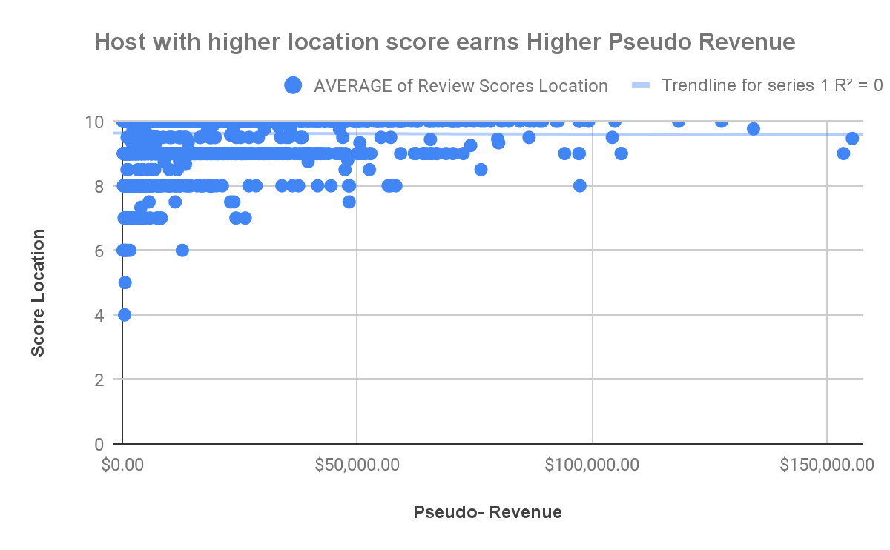
Higher Location Score, Higher Pseudo Revenue
The Higher the listing score on Location and Score Value, more pseudo-revenue
This proved to be true
This will provide guidance for host to promote attracted activities like restaurants, Movie theaters, Amusement Parks close by.
(Insert Visual Here)

Slide 4
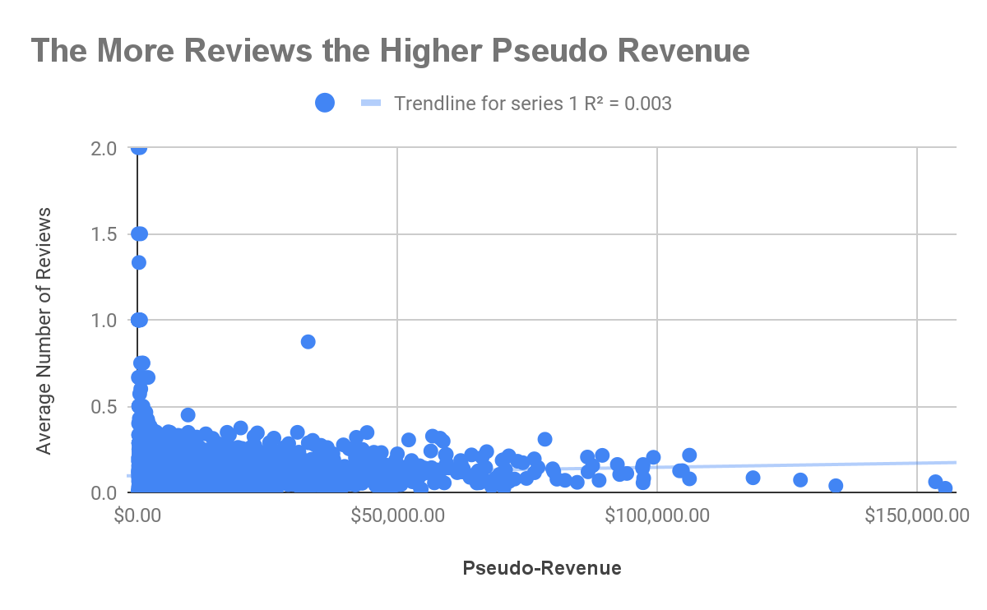
The More Reviews, More Pseudo-Revenue
The more reviews leads to more pseudo-revenue
It was not highly correlated as I had anticipated .
There may be negatives as well as positive and that can affect the host pseudo-revenue because of the outliers
(Insert Visual Here)

Slide 5
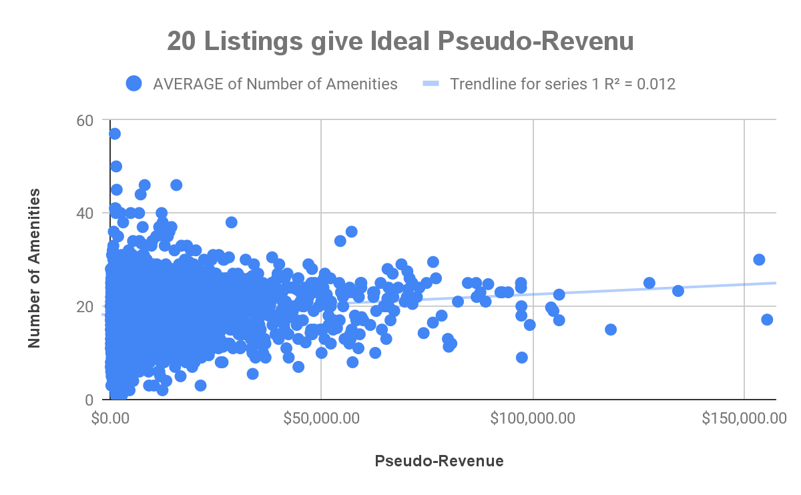
More Amenities Listed, More Pseudo-Revenue)
The more Amenities listed the more pseudo-revenue
Pseudo Amenities flattens after 19 Amenities.
There will not be much financial benefit at 20 listing Amenities diminishing returns set in after from 20

Slide 6
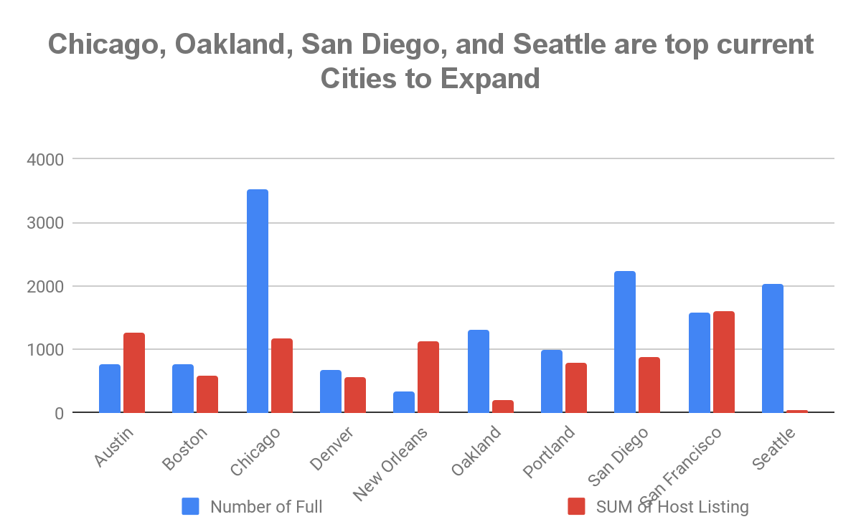
Top current Cities to Expand
My analysis changed to seeing how many listing there were in each city vs how many full service restaurants there were. i created a column for listing which is total number of listing s managed by host
I inferred that more restaurants means more population and that more rooms for the company to expand or grow in these cities. Seattle was

Slide 7
My insight
3. This proved true to (higher scores on value and location results in more pseudo-revenue).
This will provide guidance for host to promote restaurants and activities close by, to promote better "location" Also the host may want to slightly lower price than their competitors and try to give little incentives like discount for nearby restaurant or movie theaters , this will let the guest believe that they are getting better deal. This will help for the guest to return much often and host rent out their spaces more to generate higher revenue..

Slide 8
My insight 2
I inferred that more restaurants means more population and that more rooms for the company to expand or grow in these cities. Seattle was the first city i would target to expand after the analysis. Seattle has a few listing (40) but full service restaurant is over 2000. Chicago,, San Diego and Oakland have similar spread also.

Slide 9
My Insight Insight 3
I will request for more data on number of reviews and 24-hour-Check-In to be able to see whether the outliers will continue to affect Pseudo-revenue positive or negative way..

